Slide 1



Thursday meeting 12.09.2019

Slide 2
Intrinsic subtypes
Claudin-low
Sørlie et al. 2003
Herschkowitz et al. 2007

Slide 3
Claudin-low breast cancer
Gene expression:
↓ Cell-cell adhesion
↑ Epithelial-mesenchymal transition
Stem-cell-like/less differentiated gene expression

Slide 4
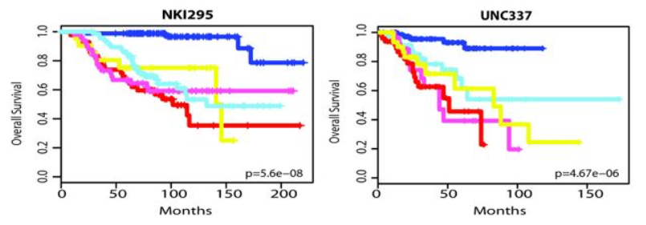
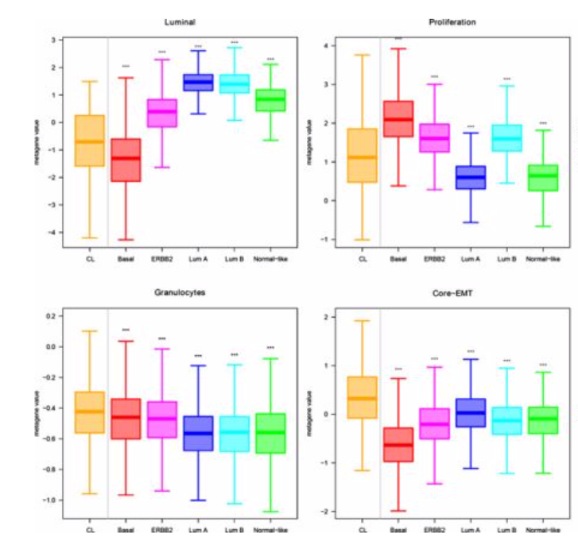
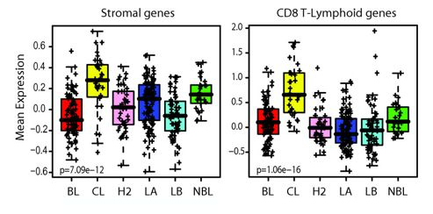
Claudin-low breast cancer
Characterized/presented as a sixth intrinsic subtype
Prat et al. 2010
Sabatier et al. 2014
Fougner et al. 2019

Slide 5
How are claudin-low tumors identified?
Identify intrinsic subtypes using PAM50 predictor
Nine-cell-line claudin-low predictor
If a tumor is classified as claudin-low → overwrite intrinsic subtype

Slide 6
Why does claudin-low classification need to be performed separately from intrinsic subtype classification? Why are claudin-low tumors so heterogeneous?

Slide 7
Hypothesis: The set of biological features encompased by the intrinsic subtypes is distinct from the set of features encompassed by claudin-low

Slide 8
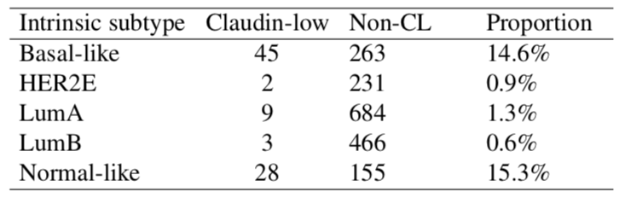
A subtype of basal-like breast cancer?
METABRIC cohort, n = 1886 (Curtis et al. 2012, Pereira et al. 2016)

Slide 9
A triple negative subgroup of breast cancer?

Slide 10
Genomically stable?

Slide 11
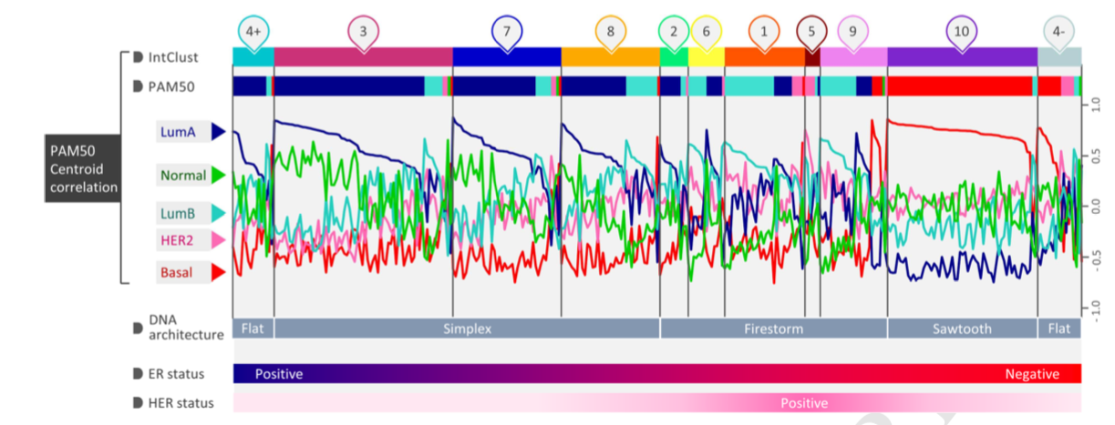
Genomically stable – IntClust4?
Russnes et al. 2017

Slide 12
Genomic stability – solution found?

Slide 13
Genomic drivers?
No cancer-associated mutations or CNAs found significantly more often in claudin-low tumors

Slide 14
Slower cycling tumor type?

Slide 15
Poor prognosis subtype?

Slide 16
Poor prognosis subtype?

Slide 17
Immune infiltration and claudin-low classification
Nine-cell line claudin-low predictor uses 807 genes
«However, we acknowledge a potential caveat of the nine-cell line claudin-low predictor, which is that tumors with high stromal content might also be identified as claudin-low.» Prat et al. 2010
Immune and stromal infiltration inferred using ESTIMATE
(gene expression-based)

Slide 18
Could a claudin-low classifier with a shorter gene list reduce the influence of normal-cell infiltration as a potentially confounding factor?

Slide 19
Condensed claudin-low gene list
19 genes
Manually selected
Only representing
↓ Cell-cell adhesion
↑ Epithelial-mesenchymal transition
Stem-cell-like/less differentiated gene expression

Slide 20
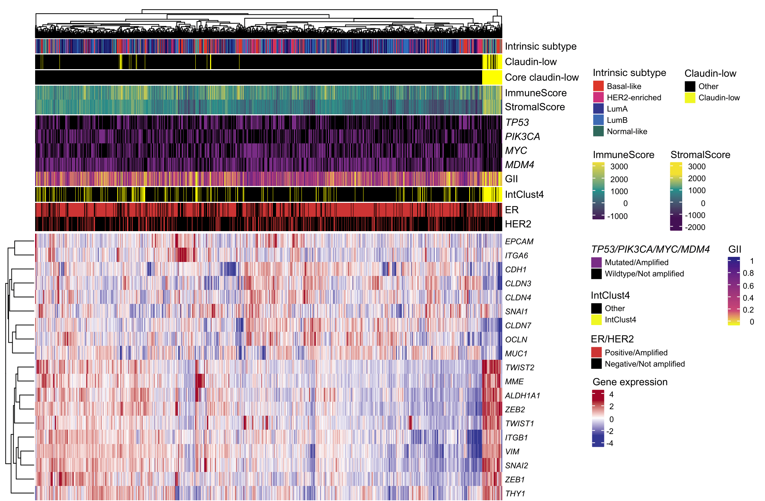

Slide 21
What’s the difference?

Slide 22
What’s the difference?

Slide 23
Does claudin-low status affect survival now?

Slide 24
Do the findings validate in other cohorts?

Slide 25
Oslo2
n = 381 tumors in cohort, 29 claudin-low (9CL), 28 CoreCL

Slide 26
TCGA
n = 1082 tumors in cohort, 32 claudin-low (9CL), 0 CoreCL

Slide 27
Why?

Slide 28
How should we interpret claudin-low then?

Slide 30
Why should we care about claudin-low?
Clinically relevant features:
Immune infiltration
High levels of PD-L1 expression
Immunsuppressed by T-regulatory cells
Low tumor mutational burden
EMT as a therapeutic target
EMT → chemoresistance

Slide 31
Thursday meeting 12.09.2019

